Slide 1
Chapter 2
Modeling in the Frequency Domain

Slide 2
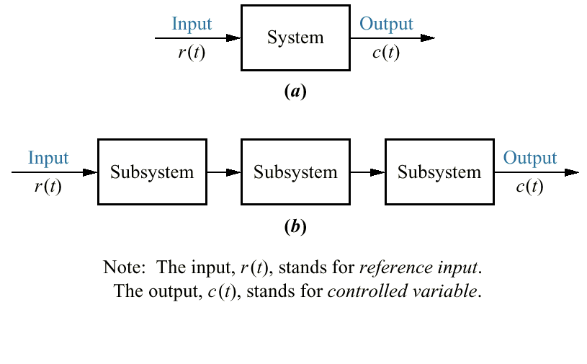
Figure 2.1
a. Block diagram
representation
of a system;
b. block diagram
representation
of an
interconnection
of subsystems

Slide 3
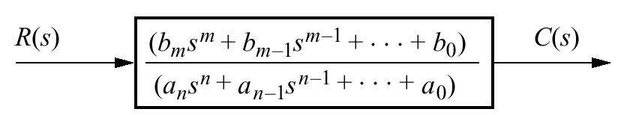
Figure 2.2
Block diagram of a
transfer function

Slide 4
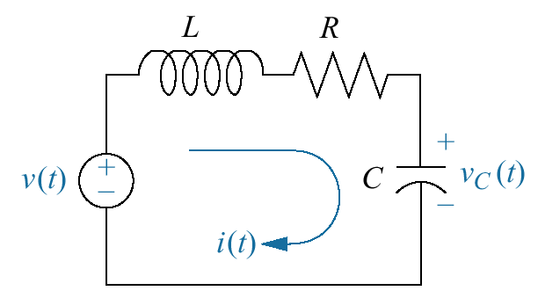
Figure 2.3
RLC network

Slide 5
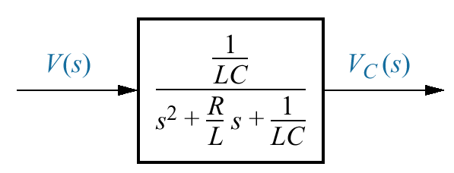
Figure 2.4
Block diagram
of series RLC electrical network

Slide 6
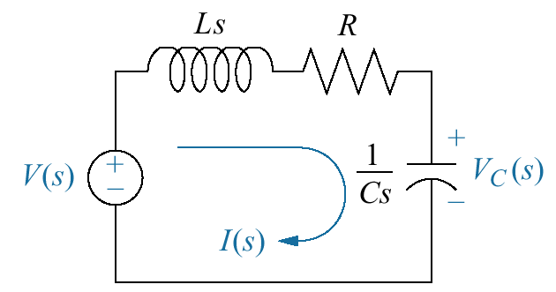
Figure 2.5
Laplace-transformed
network

Slide 7
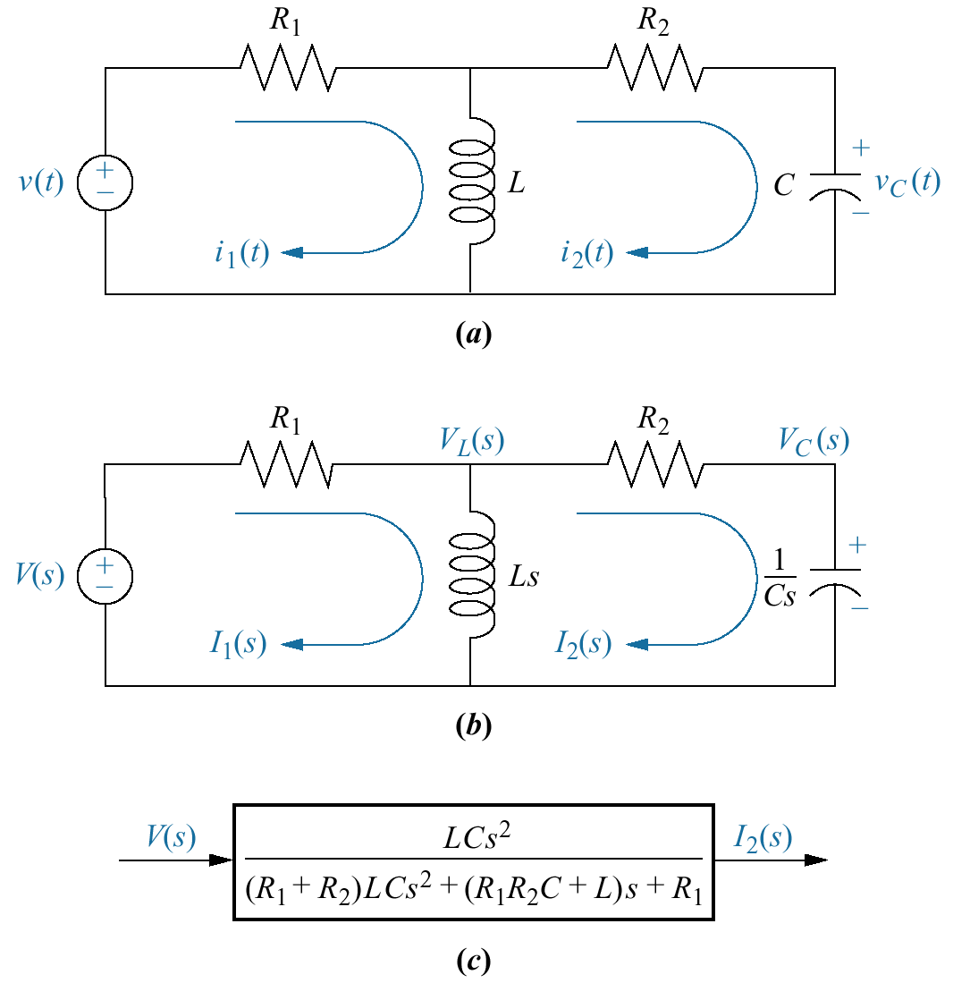
Figure 2.6
a. Two-loop electrical
network;
b. transformed
two-loop
electrical
network;
c. block diagram

Slide 8
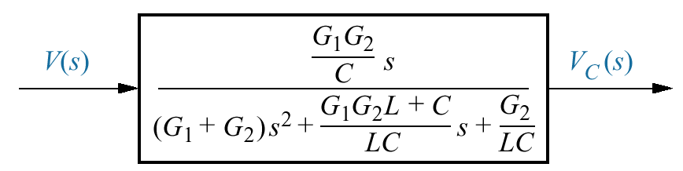
Figure 2.7
Block diagram of the
network of Figure 2.6

Slide 9
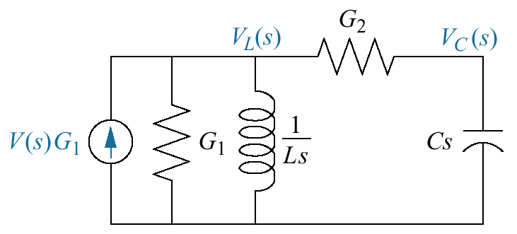
Figure 2.8
Transformed
network ready
for nodal analysis

Slide 10
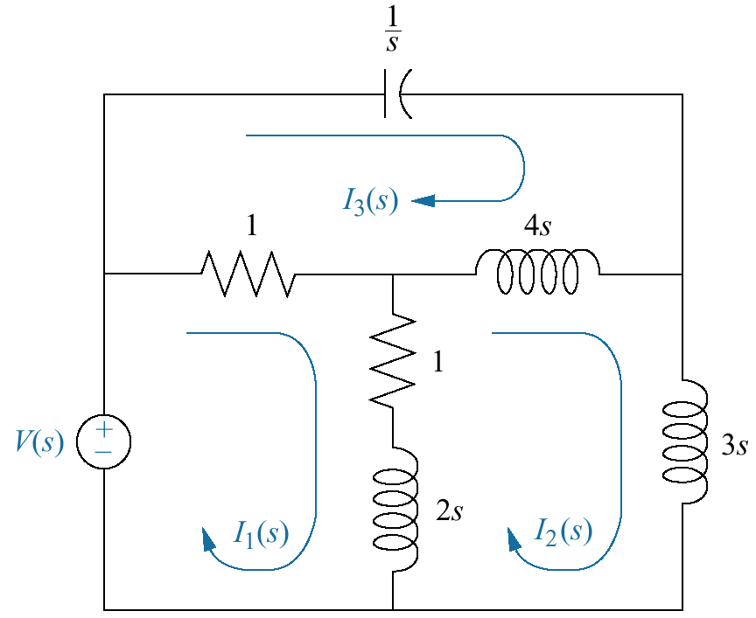
Figure 2.9
Three-loop
electrical network

Slide 11
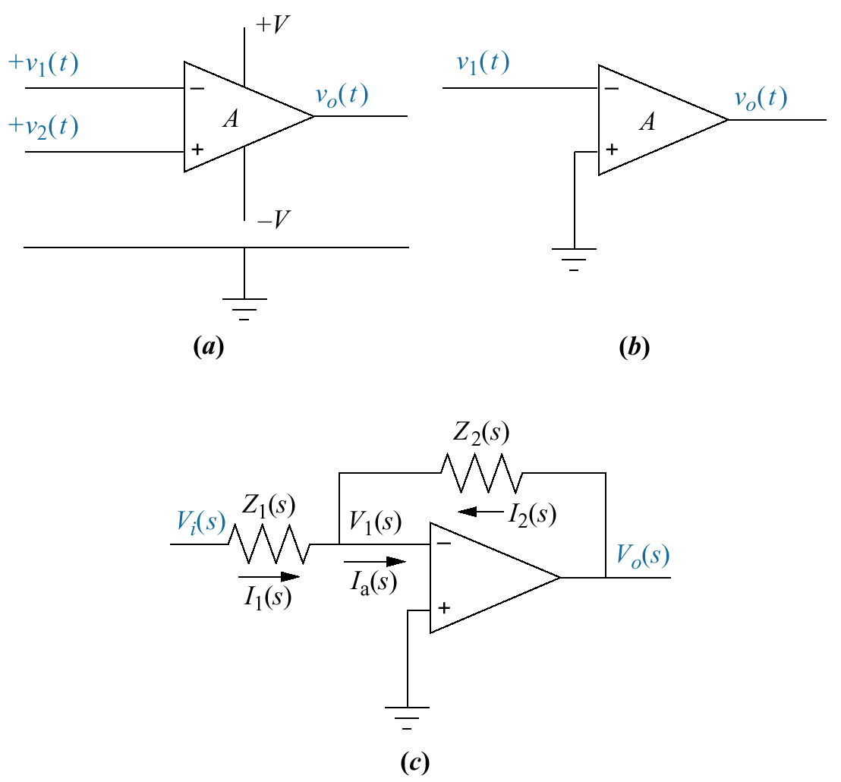
Figure 2.10
a. Operational
amplifier;
b. schematic for an
inverting operational
amplifier;
c. inverting
operational amplifier
configured for transfer
function realization.
Typically, the amplifier
gain, A, is omitted.

Slide 12
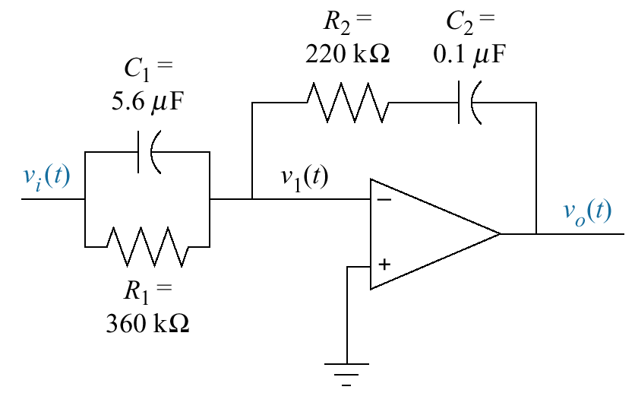
Figure 2.11
Inverting operational
amplifier circuit for
Example 2.14

Slide 13
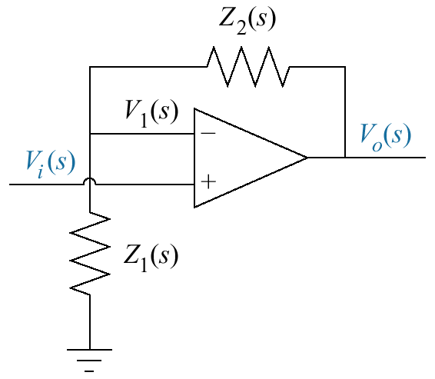
Figure 2.12
General noninverting
operational amplifier
circuit

Slide 14
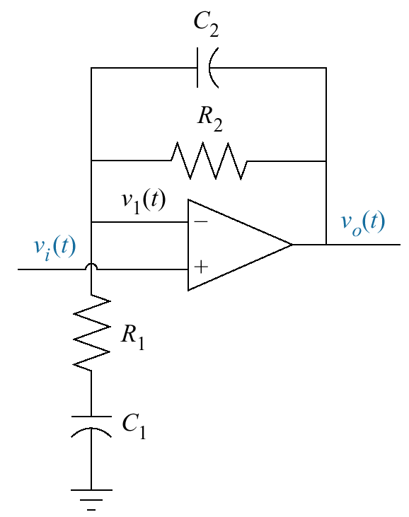
Figure 2.13
Noninverting
operational amplifier
circuit for
Example 2.15

Slide 15
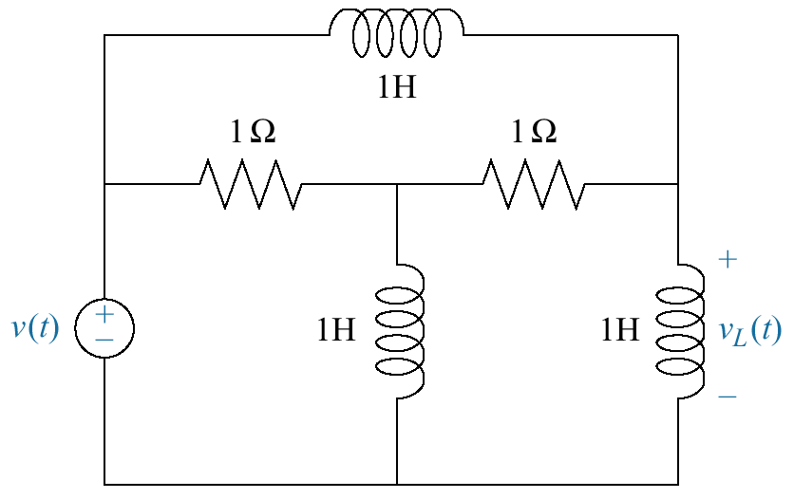
Figure 2.14
Electric circuit for
Skill-Assessment
Exercise 2.6

Slide 16
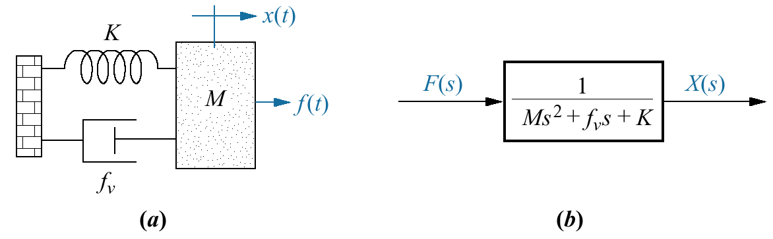
Figure 2.15
a. Mass, spring, and
damper system;
b. block diagram

Slide 17
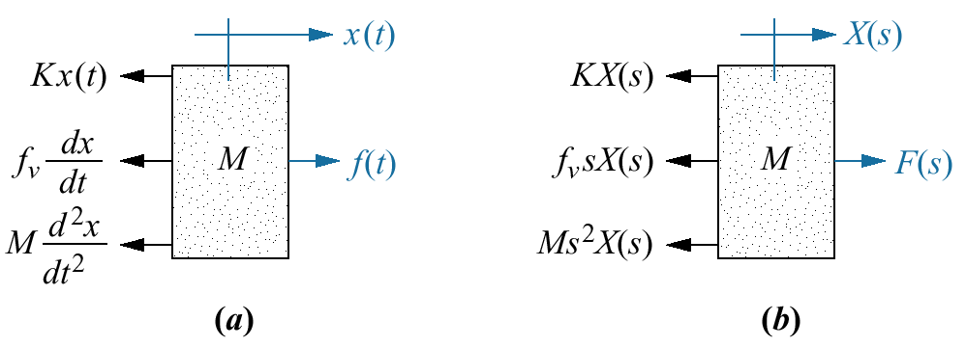
Figure 2.16
a. Free-body diagram
of mass, spring, and
damper system;
b. transformed free-
body diagram

Slide 18
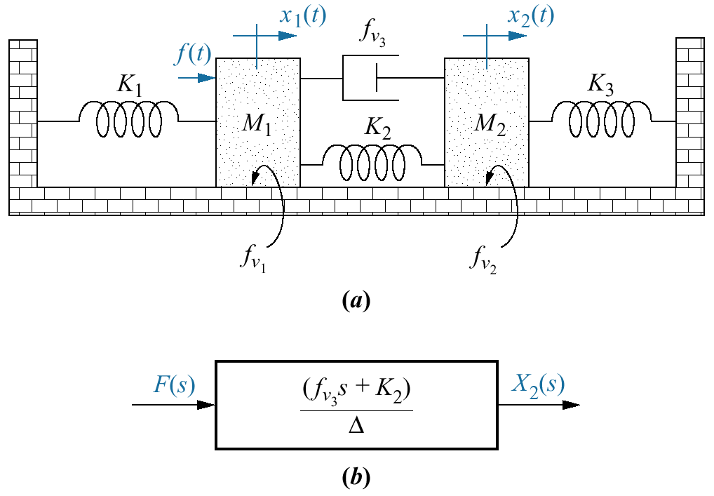
Figure 2.17
a. Two-degrees-of-
freedom translational
mechanical system⁸;
b. block diagram

Slide 19
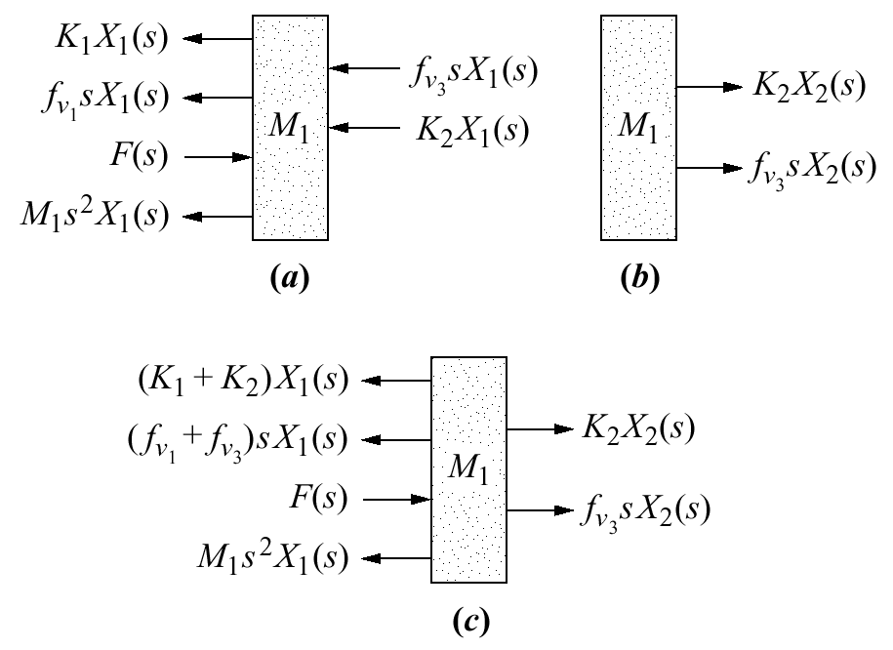
Figure 2.18
a. Forces on M₁ due
only to motion of M₁
b. forces on M₁ due
only to motion of M₂
c. all forces on M₁

Slide 20
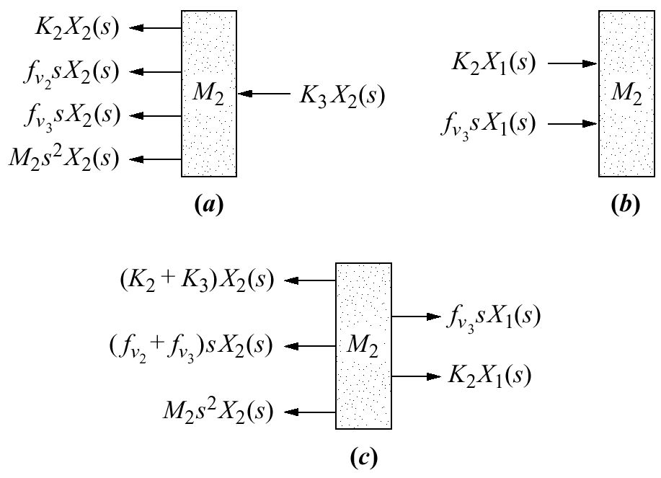
Figure 2.19
a. Forces on M₂ due
only to motion of M₂;
b. forces on M₂ due
only to motion of M₁;
c. all forces on M₂

Slide 21
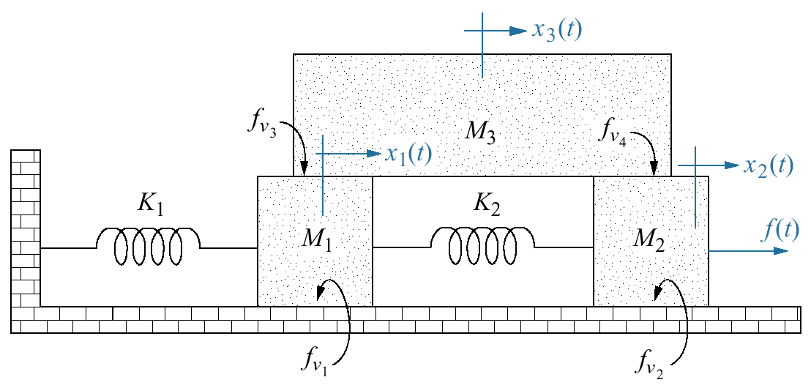
Figure 2.20
Three-degrees-of-freedom
translational
mechanical system

Slide 22
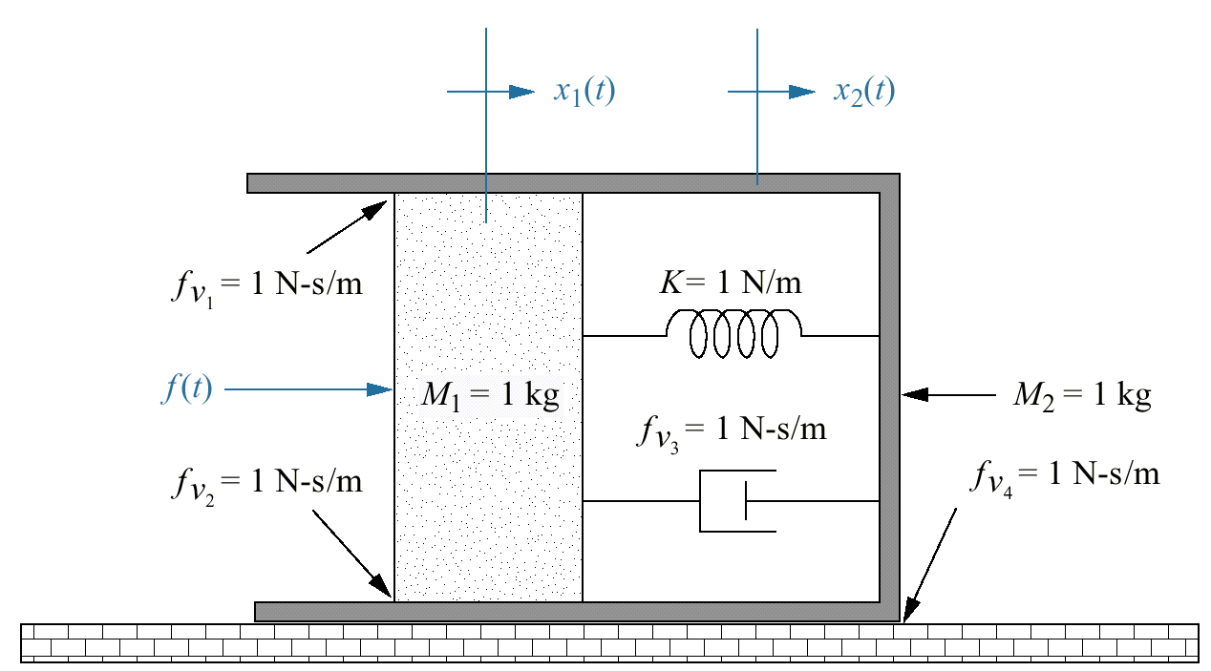
Figure 2.21
Translational
mechanical system
for Skill-Assessment
Exercise 2.8

Slide 23
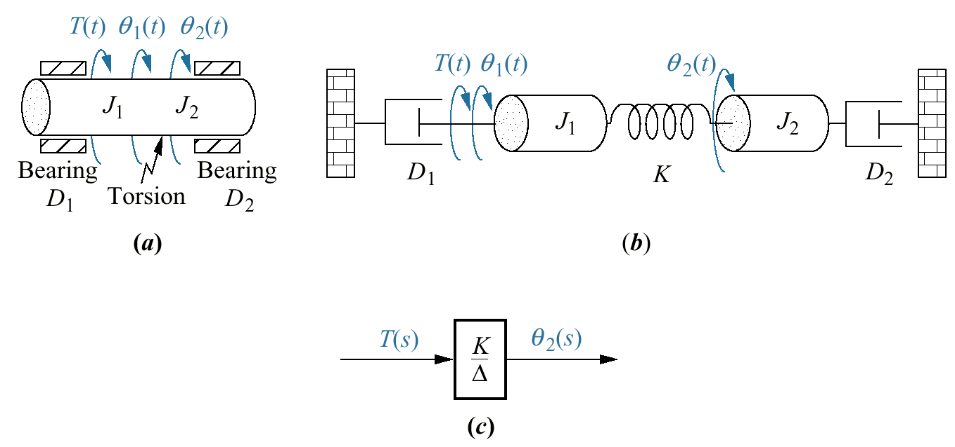
Figure 2.22
a. Physical system;
b. schematic;
c. block diagram

Slide 24
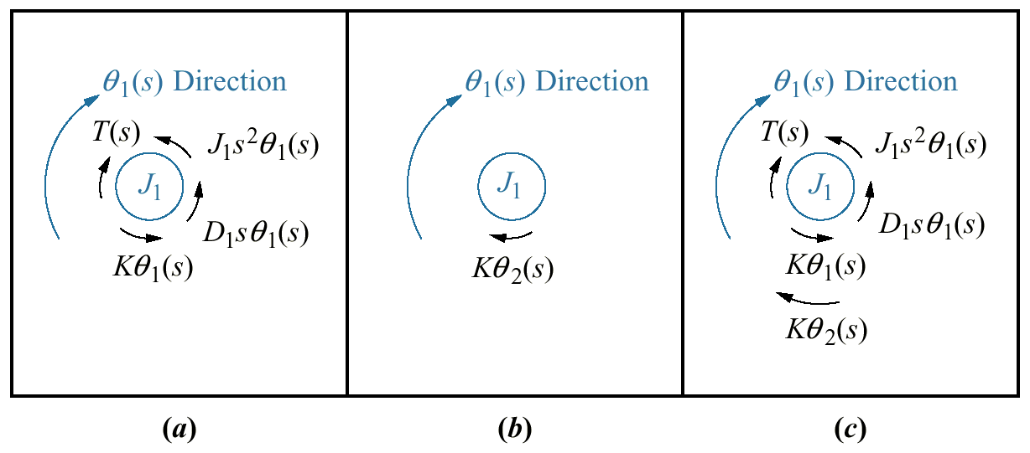
Figure 2.23
a. Torques on J₁
due only to the
motion of J₁
b. torques on J₁
due only to the
motion of J₂
c. final free-body
diagram for J₁

Slide 25
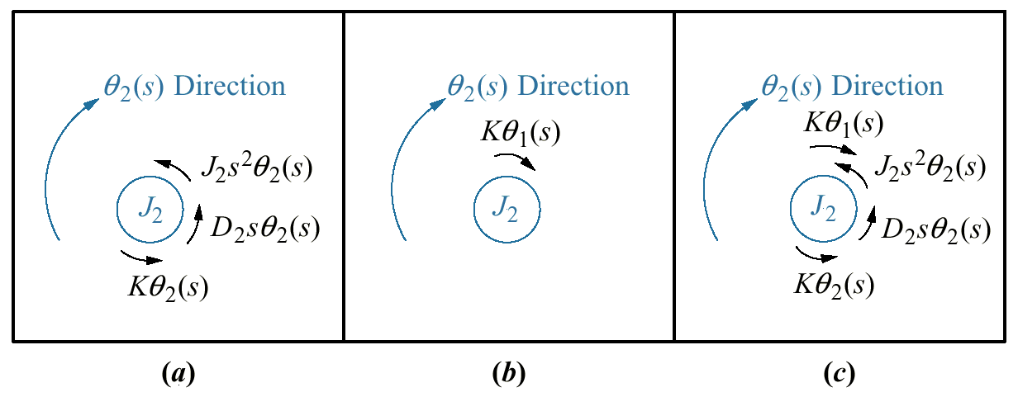
Figure 2.24
a. Torques on J₂
due only to the
motion of J₂;
b. torques on J₂
due only to the
motion of J₁
c. final free-body
diagram for J₂

Slide 26
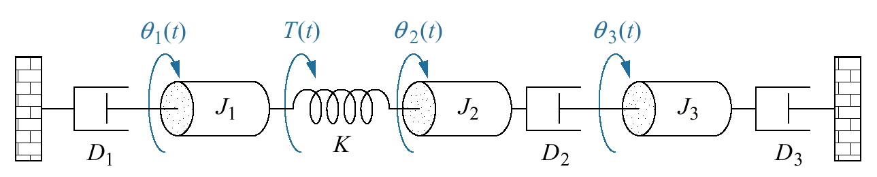
Figure 2.25
Three-degrees-of-
freedom rotational
system

Slide 27
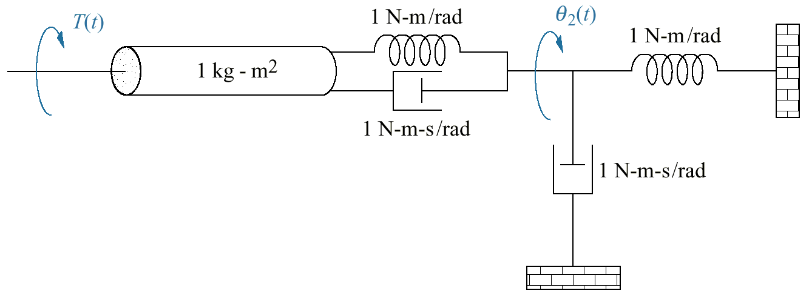
Figure 2.26
Rotational
mechanical system
for Skill-Assessment
Exercise 2.9

Slide 28
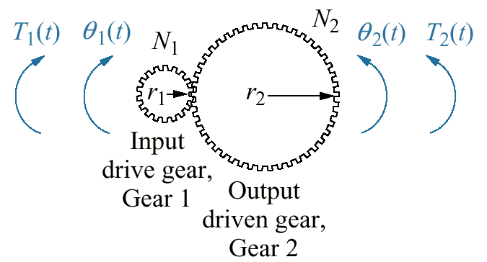
Figure 2.27
A gear system

Slide 29
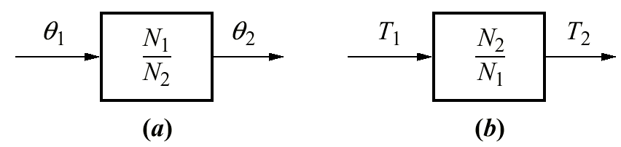
Figure 2.28
Transfer functions for
a. angular displacement in
lossless gears and
b. torque in lossless
gears

Slide 30
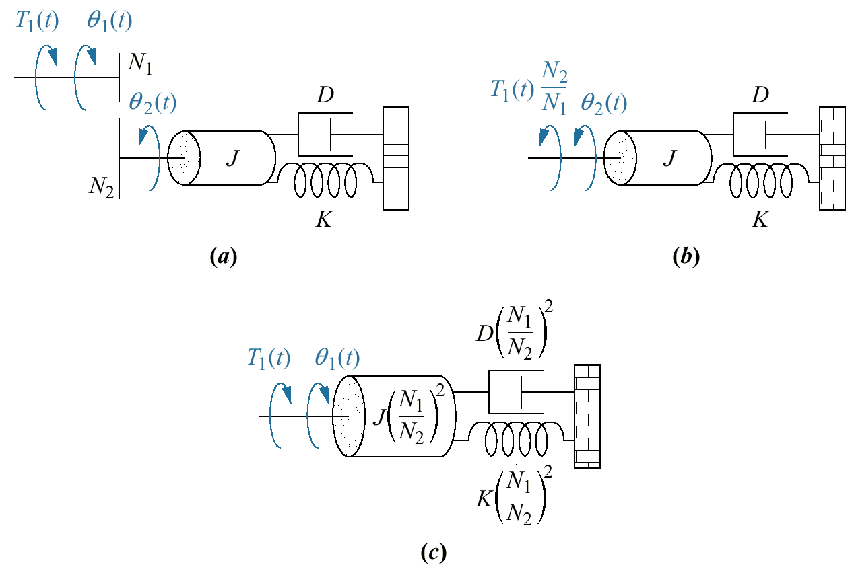
Figure 2.29
a. Rotational
system driven
by gears;
b. equivalent
system
at the output after
reflection of input
torque;
c. equivalent
system
at the input after
reflection of
impedances

Slide 31
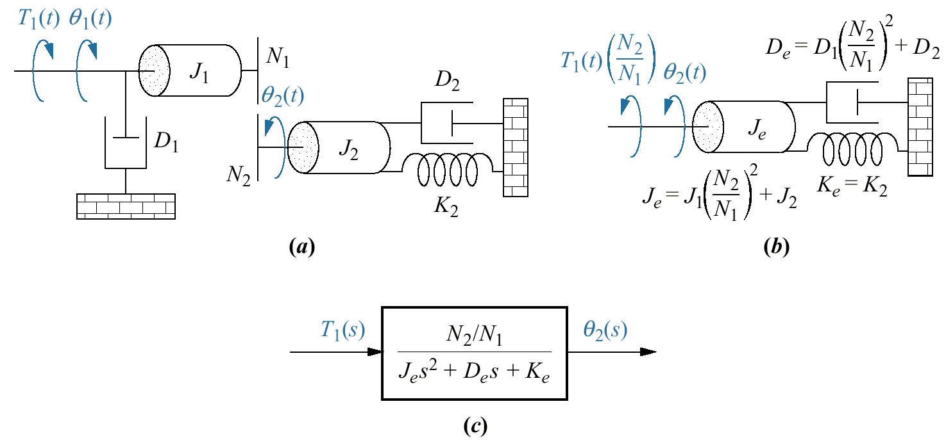
Figure 2.30
a. Rotational mechanical system with gears;
b. system after reflection of
torques and impedance to the output shaft;
c. block diagram

Slide 32
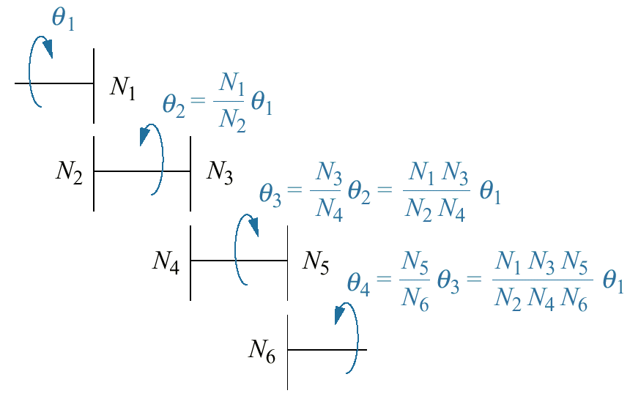
Figure 2.31
Gear train

Slide 33
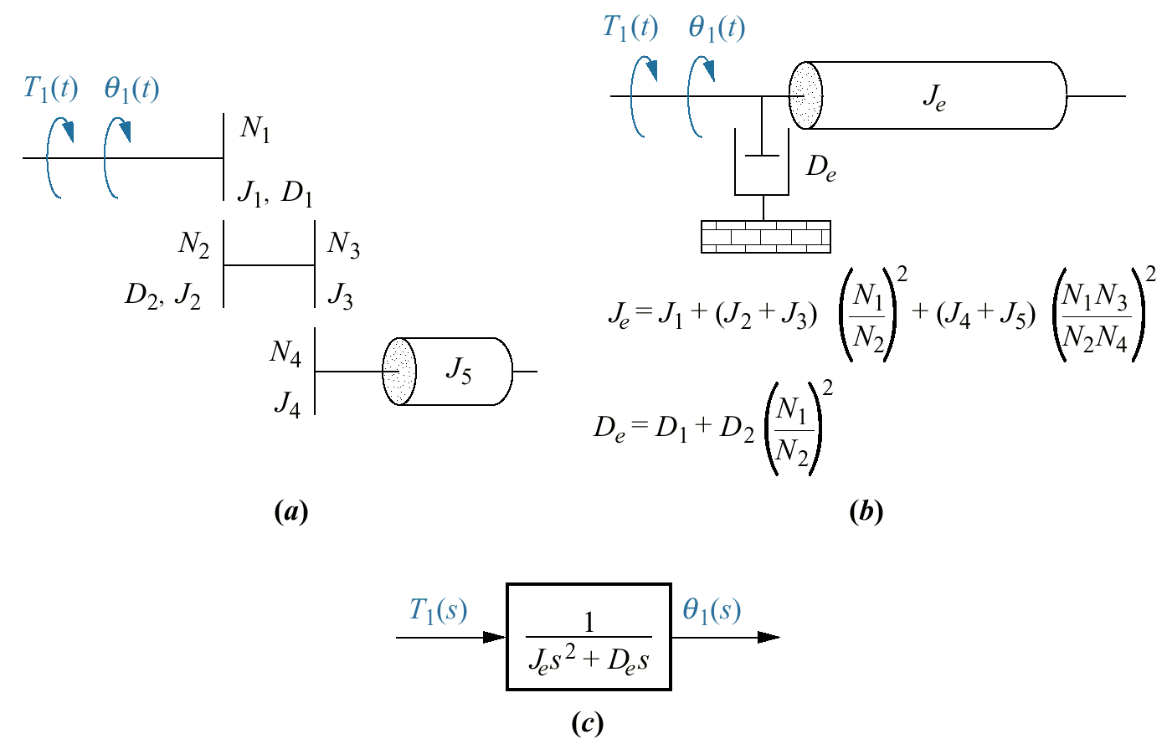
Figure 2.32
a. System using a gear train;
b. equivalent system at the input;
c. block diagram

Slide 34
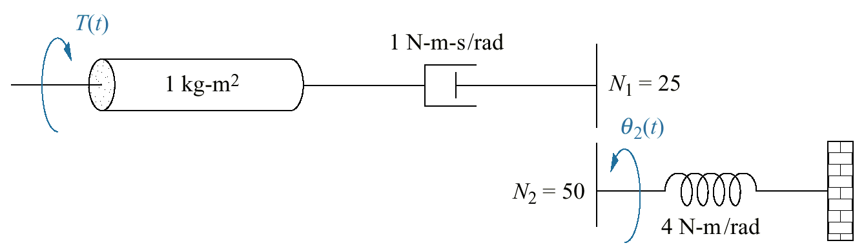
Figure 2.33
Rotational mechanical
system with gears
for Skill-Assessment
Exercise 2.10

Slide 35
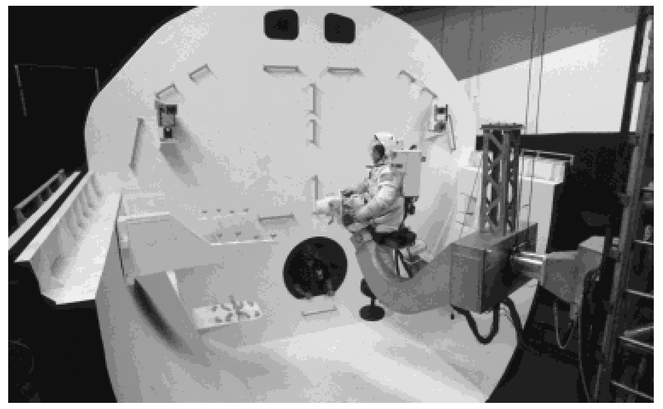
Figure 2.34
NASA flight
simulator
robot arm with
electromechanical
control system
components

Slide 36
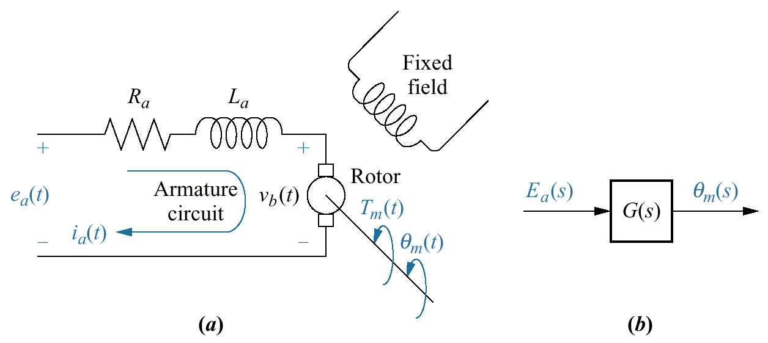
Figure 2.35
DC motor:
a. schematic¹²;
b. block diagram

Slide 37
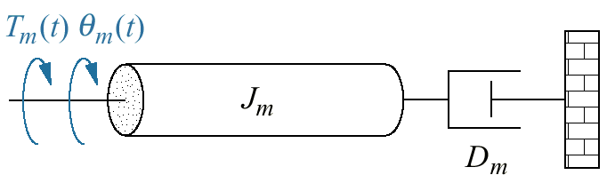
Figure 2.36
Typical equivalent
mechanical loading
on a motor

Slide 38
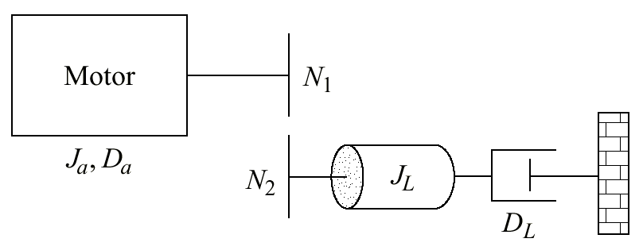
Figure 2.37
DC motor driving a
rotational mechanical
load

Slide 39
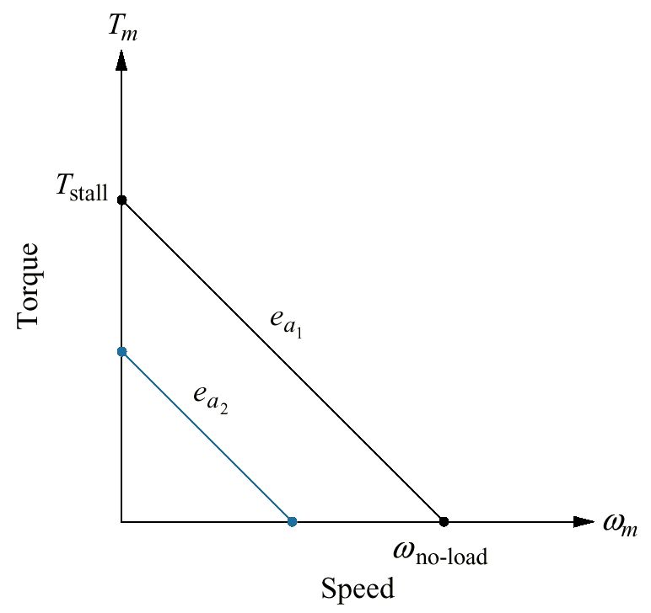
Figure 2.38
Torque-speed
curves with an armature
voltage, e_{a}, as
a parameter

Slide 40
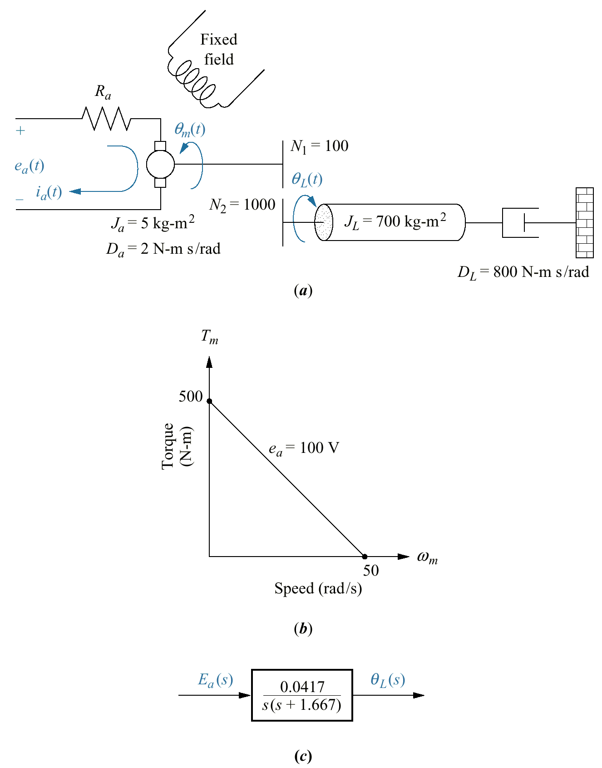
Figure 2.39
a. DC motor and load;
b. torque-speed curve;
c. block diagram

Slide 41
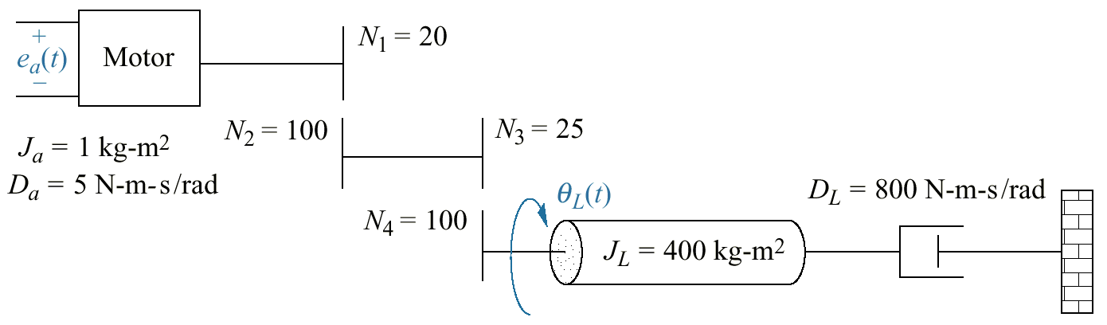
Figure 2.40
Electromechanical
system for
Skill-Assessment
Exercise 2.11

Slide 42
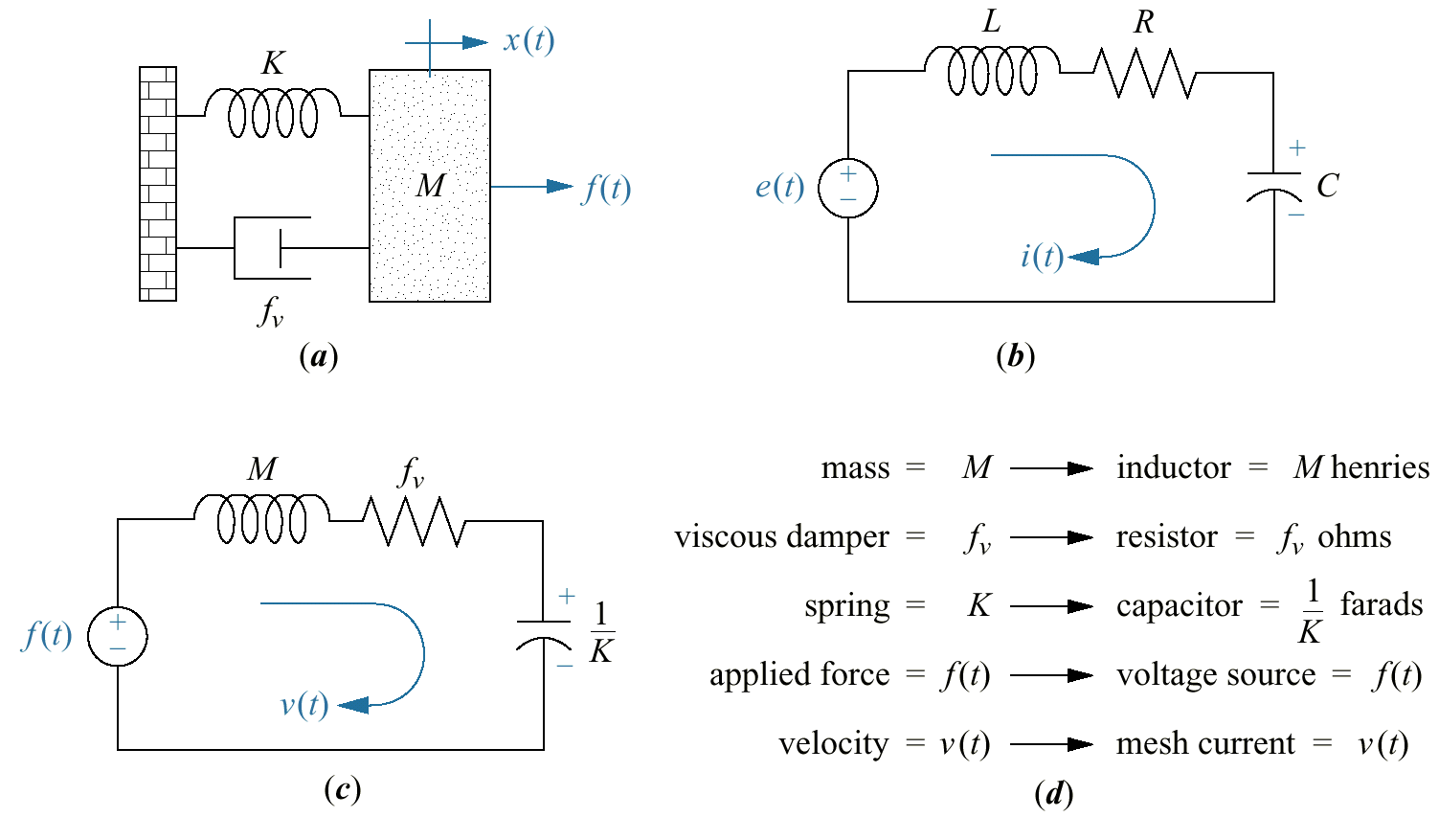
Figure 2.41
Development of
series analog:
a. mechanical
system;
b. desired electrical
representation;
c. series analog;
d. parameters for
series analog

Slide 43
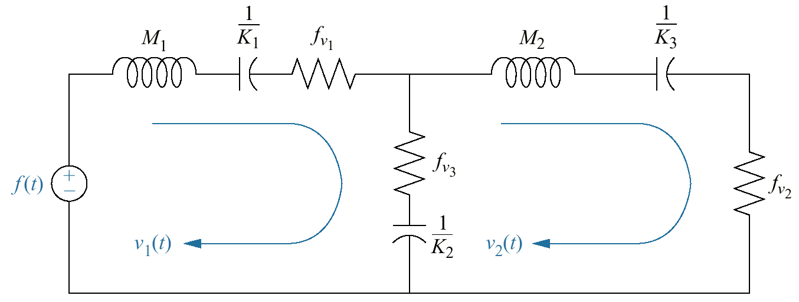
Figure 2.42
Series analog of
mechanical system
of Figure 2.17(a)

Slide 44
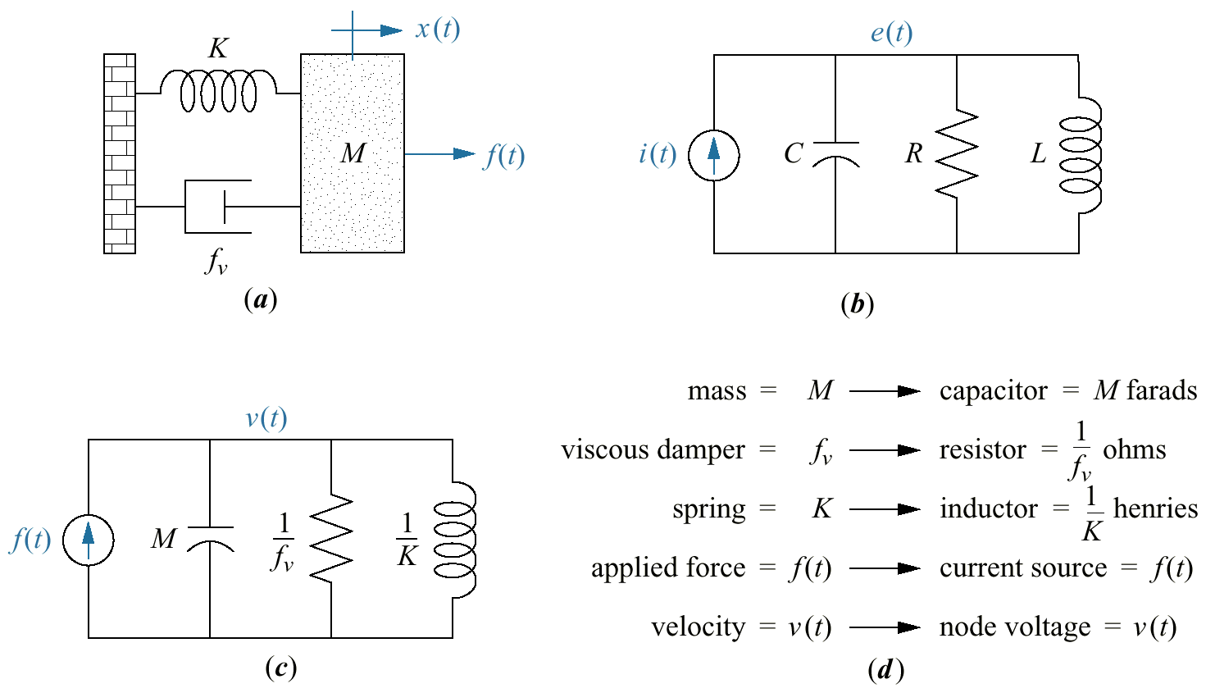
Figure 2.43
Development of
parallel analog:
a. mechanical
system;
b. desired
electrical
representation;
c. parallel analog;
d. parameters for
parallel analog

Slide 45
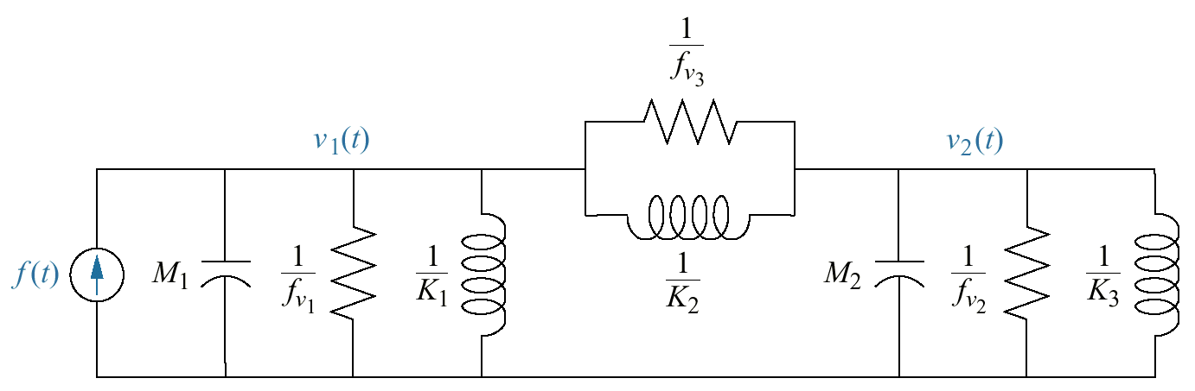
Figure 2.44
Parallel analog of
mechanical system
of Figure 2.17(a)

Slide 46
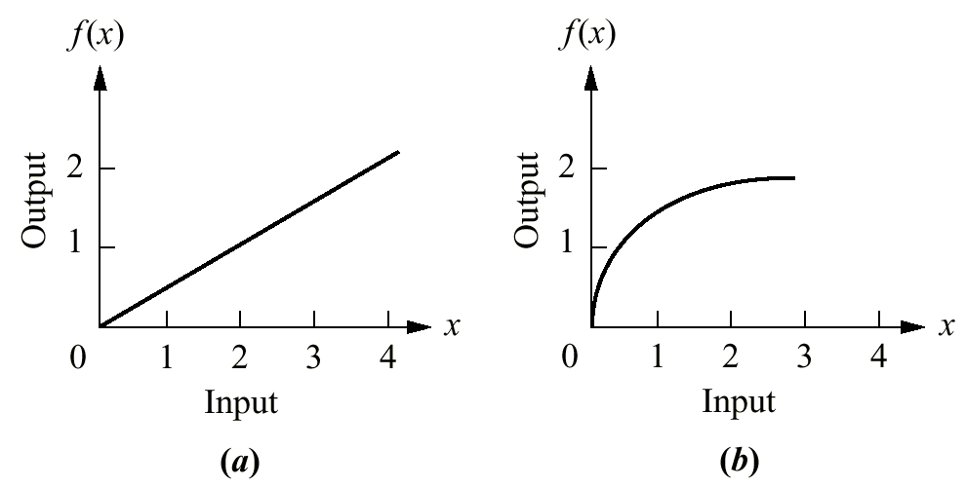
Figure 2.45
a. Linear system;
b. nonlinear system

Slide 47
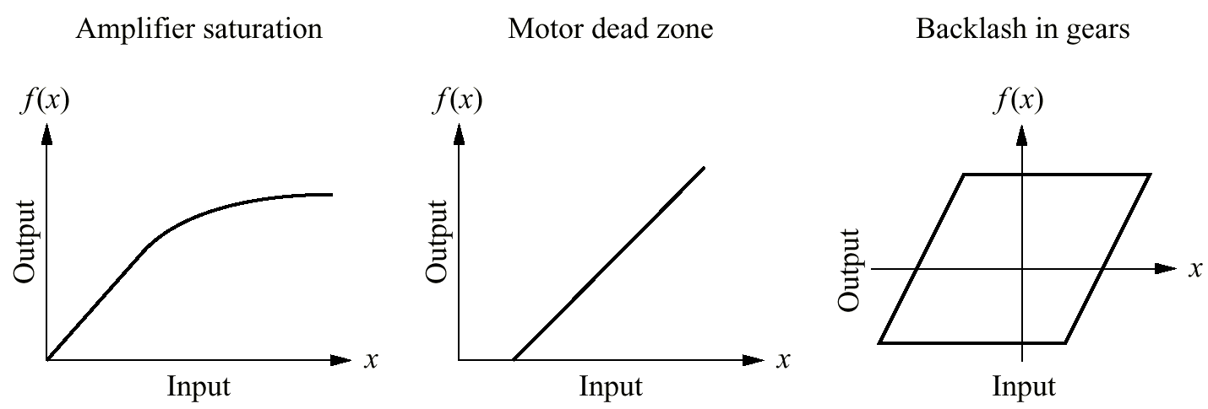
Figure 2.46
Some physical
nonlinearities

Slide 48
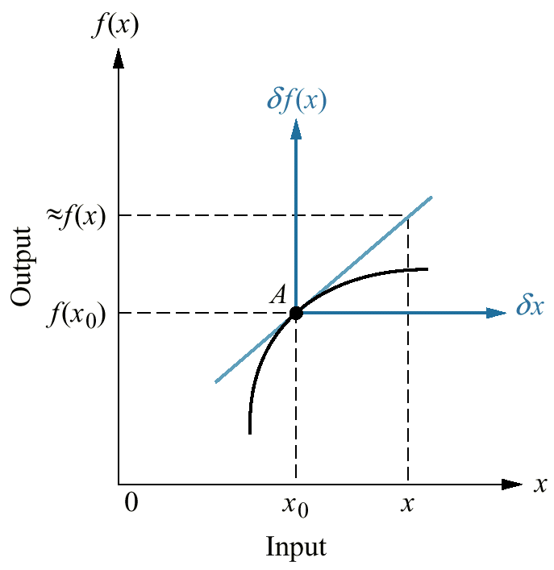
Figure 2.47
Linearization
about a point A

Slide 49
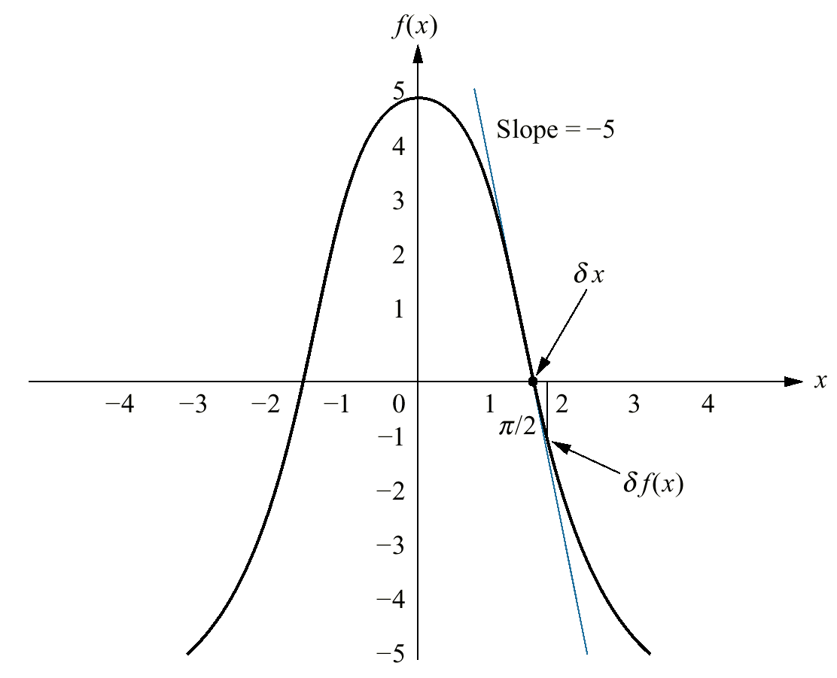
Figure 2.48
Linearization
of 5 cos x about
x = π/2

Slide 50
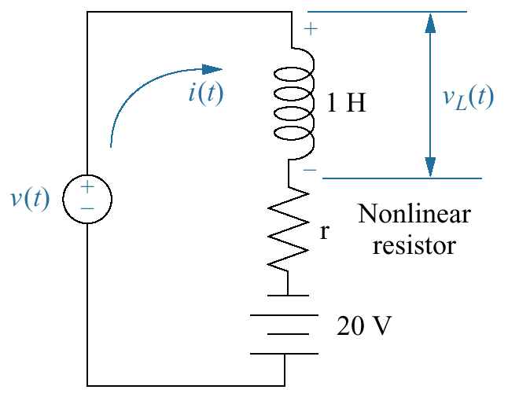
Figure 2.49
Nonlinear
electrical
network

Slide 51
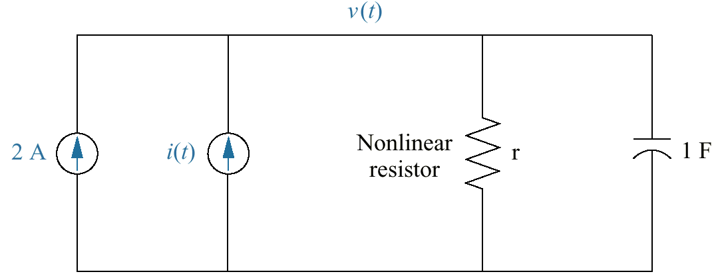
Figure 2.50
Nonlinear electric
circuit for
Skill-Assessment
Exercise 2.13

Slide 52

Figure 2.51
Cylinder model
of a
human leg

Slide 53

Figure 2.52
Free-body diagram of
leg model

Slide 54

Figure 2.53
Nonlinear electric
circuit

Slide 55

Figure P2.1

Slide 56

Figure P2.2

Slide 57

Figure P2.3

Slide 58

Figure P2.4

Slide 59

Figure P2.5

Slide 60

Figure P2.6

Slide 61

Figure P2.7

Slide 62

Figure P2.8

Slide 63

Figure P2.9

Slide 64

Figure P2.10

Slide 65

Figure P2.11

Slide 66

Figure P2.12

Slide 67

Figure P2.13

Slide 68

Figure P2.14

Slide 69

Figure P2.15

Slide 70

Figure P2.16

Slide 71

Figure P2.17

Slide 72

Figure P2.18

Slide 73

Figure P2.19

Slide 74

Figure P2.20

Slide 75

Figure P2.21

Slide 76

Figure P2.22

Slide 77

Figure P2.23

Slide 78

Figure P2.24

Slide 79

Figure P2.25

Slide 80

Figure P2.26

Slide 81

Figure P2.27

Slide 82

Figure P2.28

Slide 83

Figure P2.29

Slide 84

Figure P2.30

Slide 85

Figure P2.31

Slide 86

Figure P2.32

Slide 87

Figure P2.33

Slide 88

Figure P2.34
Plate dispenser

Slide 89

Figure P2.35
a. Coupling of
pantograph and
catenary;
b. simplified
representation
showing the
active-control
force

